Slide 1

Learning Management System
Project(2104CS600)
BCA SEMESTER-6
Garala Renil 22030401061
Internal Guide:
Asst.Prof. Chirag Sakhrani
DICA, Darshan University

Slide 2
Outline
Abstract
Problems of Existing System
Scope & Advantage
System Requirement
Module List
Module Detailing
System Design
Database Schema
Screenshots
Limitations
Conclusion
Reference
2104CS600 (Project)
2

Slide 3



Abstract

Slide 4
Abstract
The Learning Management System is an online platform that helps students learn by joining courses.
This project will include multiple course enrolment, study material access, lifetime course access, student management.
This system will allow instructors to create and manage courses, upload study materials, and interact with students.
LMS will offer a user-friendly dashboard for easy navigation and a smooth learning experience.
The platform will provide admins with tools to manage users, courses, and track overall system performance.
4

Slide 5
Problems of Existing System

Slide 6
Problems of Existing System
When describing problems in an existing Learning Management System (LMS), it is important to find issues that make learning difficult or slow. These problems can affect students, teachers, or how the system works. Here are some common problems that an LMS might have:
Limited User Experience:
LMS platform have a dull and basic design with few interactive features, making learning boring and less engaging for students.
Slow Performance:
System experience lag or slow loading times, reducing efficiency and frustrating users.
Incomplete or Outdated Course Information:
Course content may not be regularly updated, leading to outdated or missing information.
Lack of Personalization:
System do not offer tailored recommendations based on student preferences and progress.

Slide 7
Problems of Existing System
Poor Communication:
Limited interaction between students and instructors reduces engagement and support.
Security Concerns:
Some systems may have weak security measures, risking unauthorized access to student data.
No Feedback System:
Students cannot see reviews or feedback from others, making it hard to evaluate course quality.

Slide 8
Scope & Advantage

Slide 9
Scope & Advantage
Easy Learning: Students can access courses and study materials from anywhere using their phone or computer.
Wide Course Selection: LMS offers a variety of courses across different subjects, giving students more learning options.
Cost-Effective: Online learning reduces the need for physical classrooms and printed materials, making education more affordable.
Flexible Learning: Courses are available 24/7, allowing students to learn at their own pace and convenience.
Better Course Selection: Students can explore course details, syllabus, and instructor profiles before enrolling.
9

Slide 10
System Requirement
Hardware Requirement :-

Slide 11
Hardware Requirement
For Server (Hosting the LMS)
Processor: Minimum Intel Core i5 / AMD Ryzen 5 (Recommended: Intel for high traffic).
RAM: Minimum 8GB RAM (Recommended: 16GB+ for better performance).
Storage: 100GB SSD minimum (Recommended: 500GB+ SSD for faster data access).
Network: Gigabit Ethernet or high-speed connection for handling multiple users.
For End Users (Students & Instructors)
Device: Any laptop, desktop, tablet, or smartphone.
Processor: Minimum Intel Core i3 or equivalent.
RAM: 4GB RAM (Recommended: 8GB for better performance).
Storage: At least 20GB of free space for course materials and downloads.
2104CS600 (Project)
11

Slide 12
System Requirement
Software Requirement :-

Slide 13
Software Requirement
Operating System: Linux (Ubuntu, CentOS) or Windows Server
Database: MongoDB (for MERN stack)
Backend: Node.js with Express.js
Frontend: React.js
Version Control: Git and GitHub/GitLab
Cloud Services (Optional): AWS, Google Cloud, or DigitalOcean for hosting
13

Slide 14
Module List

Slide 15
Module List
Admin(Instructors) :-
User:-
Login
Add/update/delete video
Add/update/delete Courses
Update user role
View all user detail
Logout
Registration
Login
Course Enrolment
Dashboard
Add to cart
View Bill
Logout
15

Slide 16
Module Detailing
Admin :-

Slide 17
Admin
Login: Allows users to access their accounts securely.
Add/Update/Delete Video: Manage course videos by adding, editing, or removing them.
Add/Update/Delete Courses: Create, modify, or remove courses from the system.
Update User Role: Change user permissions (e.g., student, admin).
View All User Details: See a list of all registered users with their information.
Logout: Securely exit the system.
2104CS600 (Project)
17

Slide 18
Module Detailing
User :-

Slide 19
User
Registration: Users can create a new account by providing basic details like name, email, and password.
Login: Users can securely log in to their accounts using their registered email and password.
Course Enrolment: Users can browse available courses and enrol in the ones they are interested in.
Dashboard: A personal page where users can see their enrolled courses, progress, and other important details.
Add to Cart: Users can select courses and add them to their cart before making a purchase.
View Bill: Users can check the total price of the courses they have added to the cart before payment.
Logout: Users can safely exit their account to keep their information secure.

Slide 20
System Design
Usecase Diagram :-

Slide 21
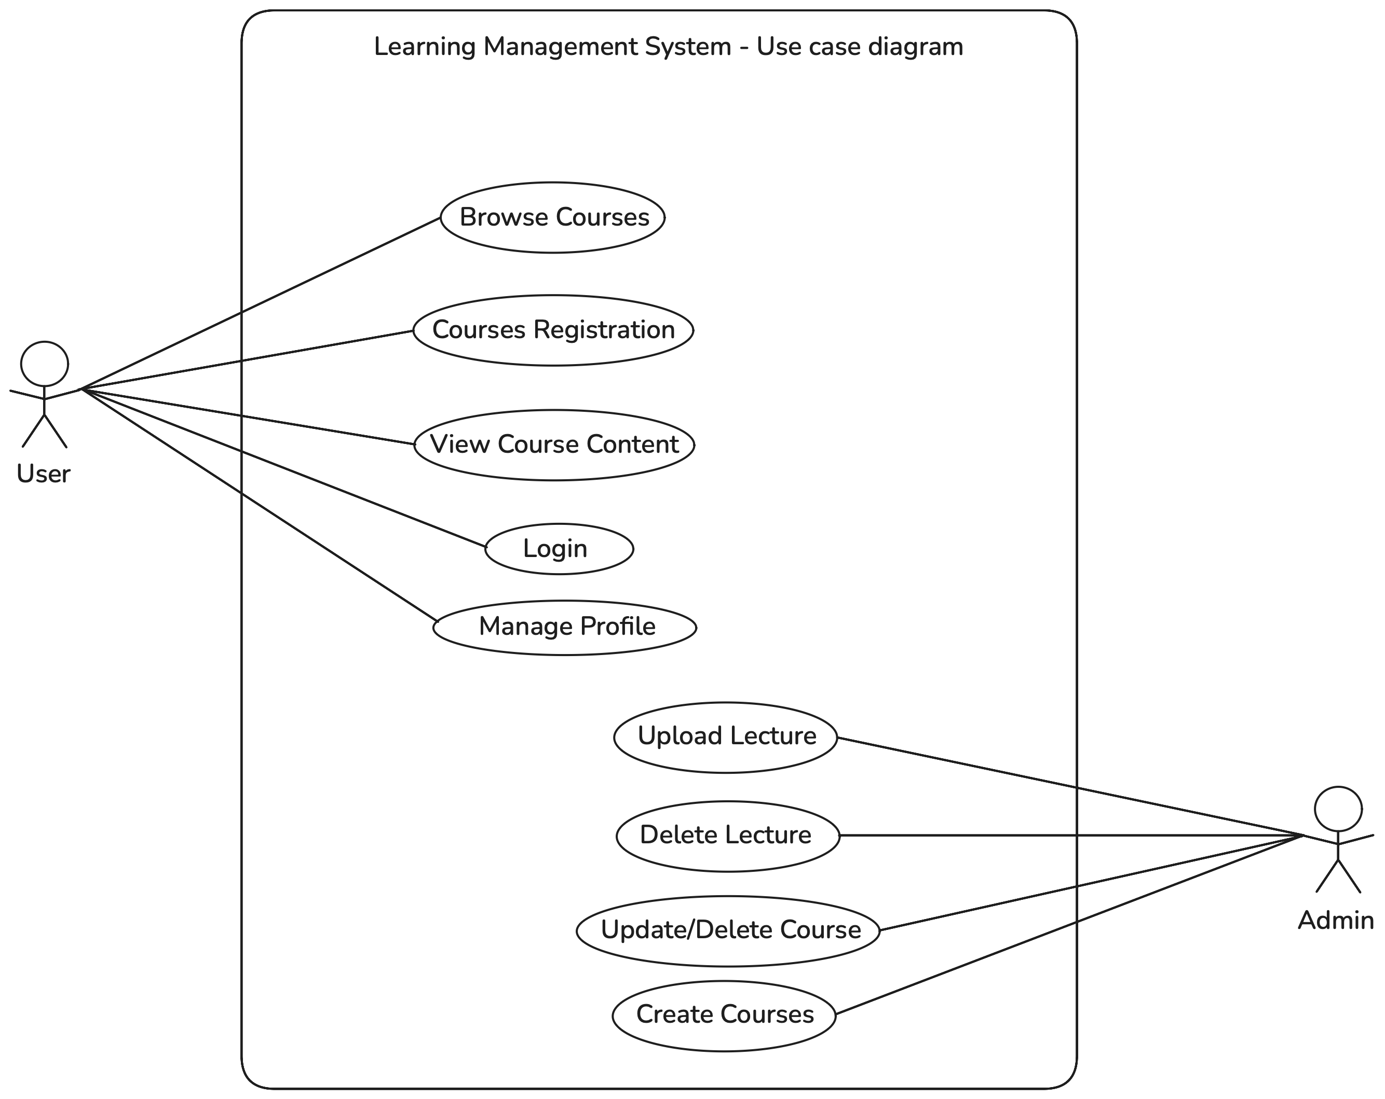
Usecase Diagram
2104CS600 (Project)
22

Slide 22
System Design
Activity Diagram :-

Slide 23
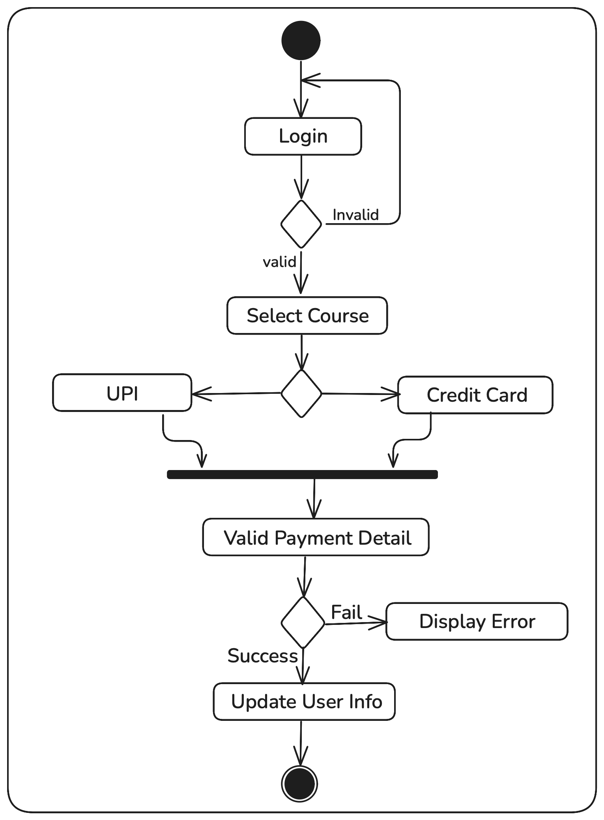
Activity Diagram : User

Slide 24
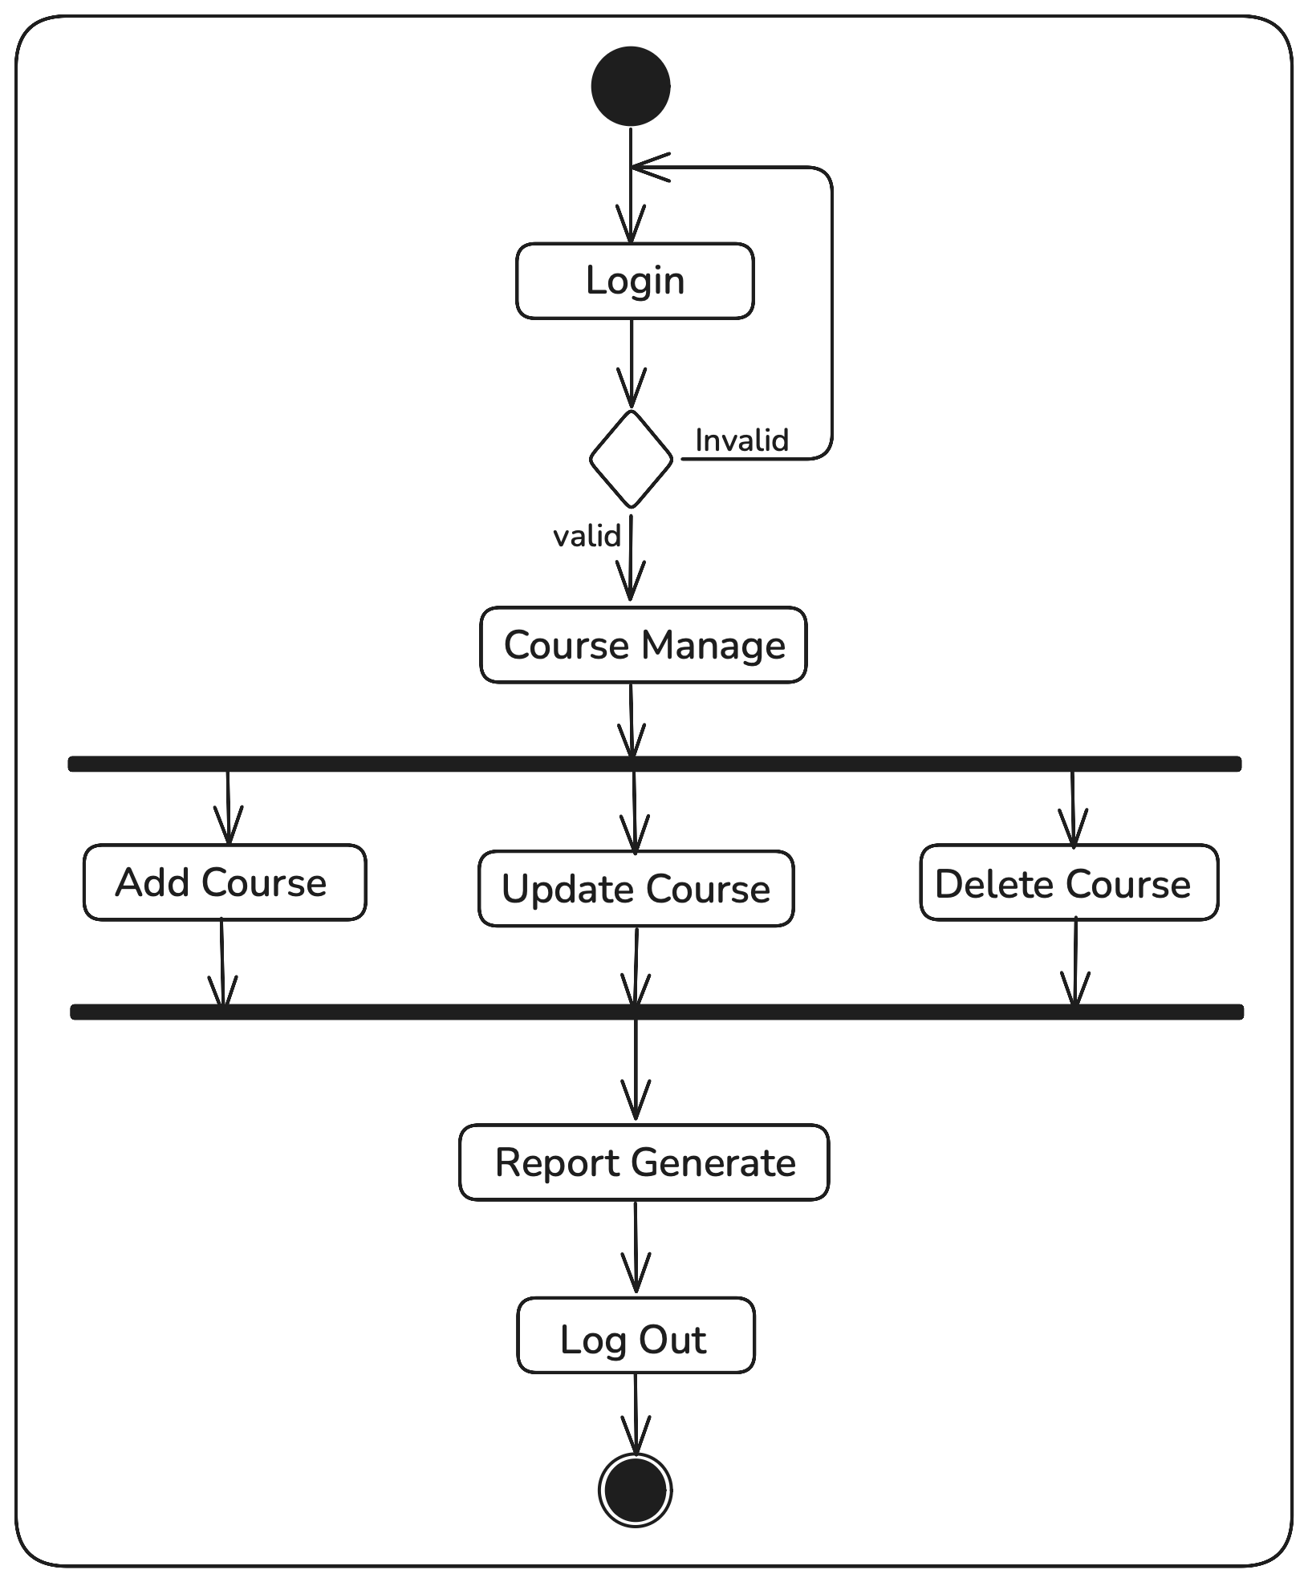
Activity Diagram : Admin

Slide 25
System Design
Data Flow Diagram :-

Slide 26
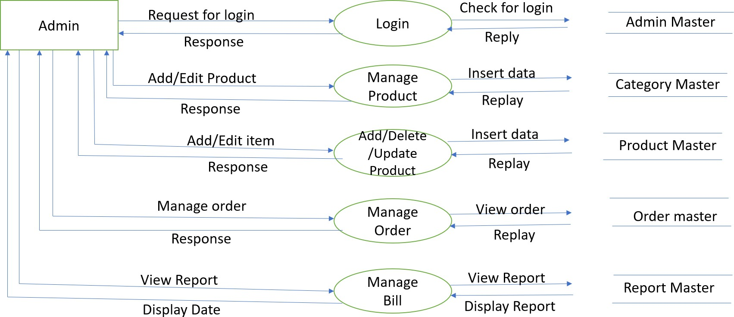
Data Flow Diagram : Admin

Slide 27
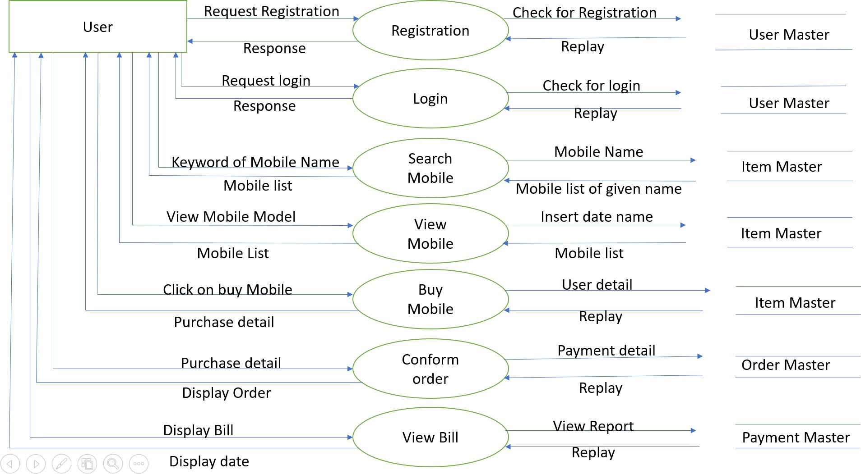
Data Flow Diagram : User

Slide 28
System Design
Entity Relation Diagram :-

Slide 29
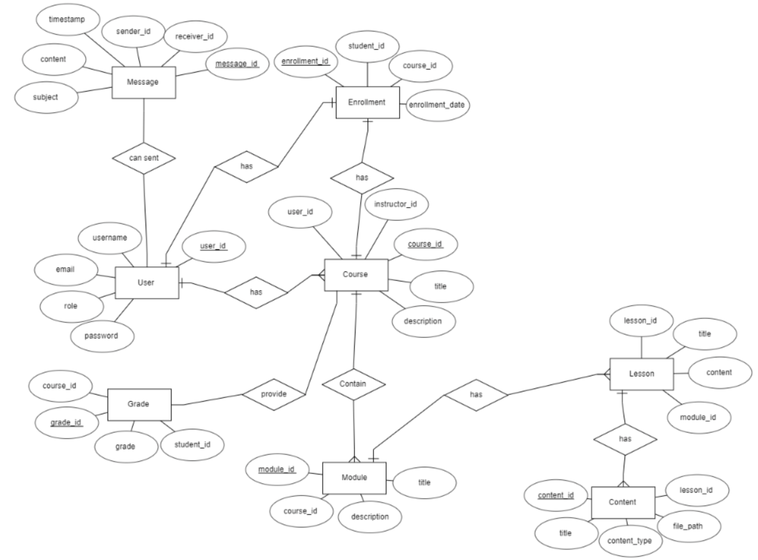
Enitiy Relation Diagram
2104CS600 (Project)
30

Slide 30
System Design
Class Diagram :-

Slide 31
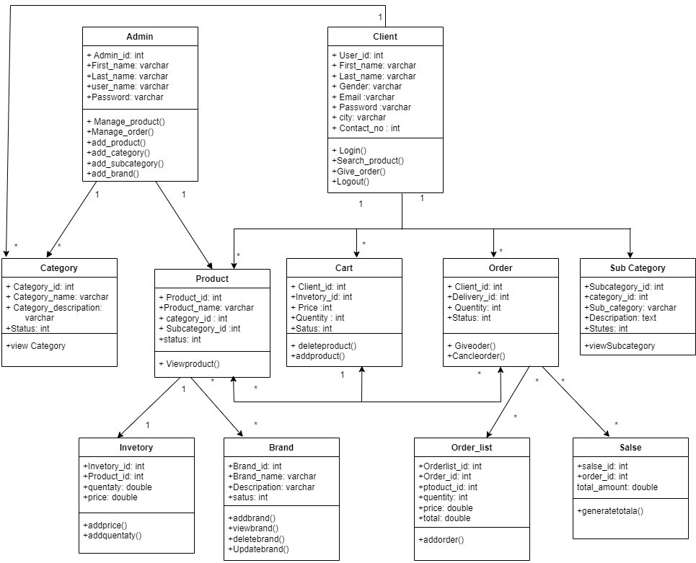
Class Diagram
32

Slide 32
Database Schema

Slide 33
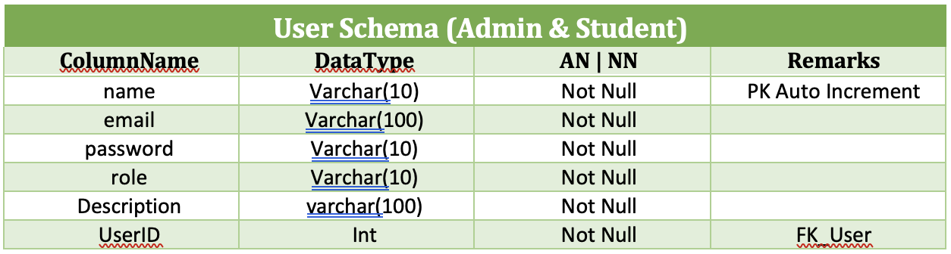
User

Slide 34
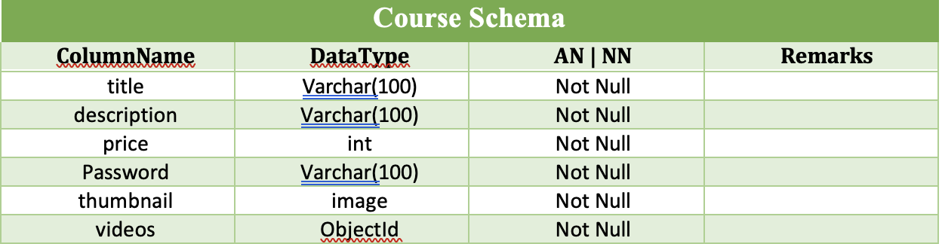
Course

Slide 35
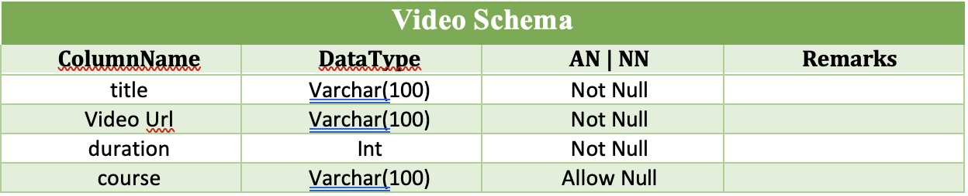
Video

Slide 36
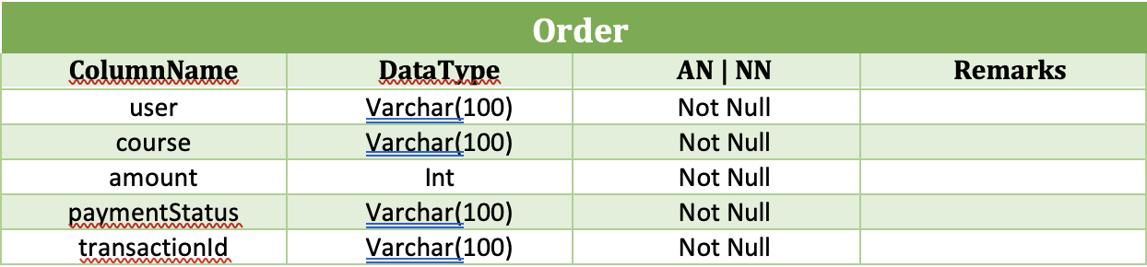
Order

Slide 37
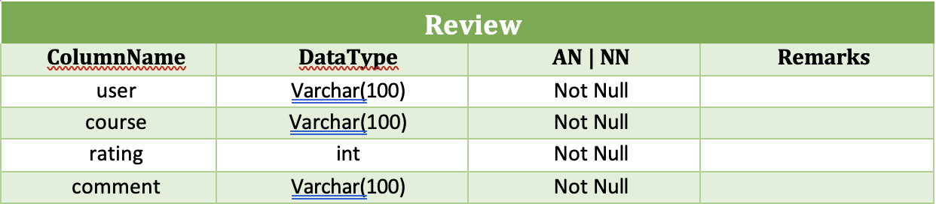
Review

Slide 38
Implementation
User Panel :-

Slide 39
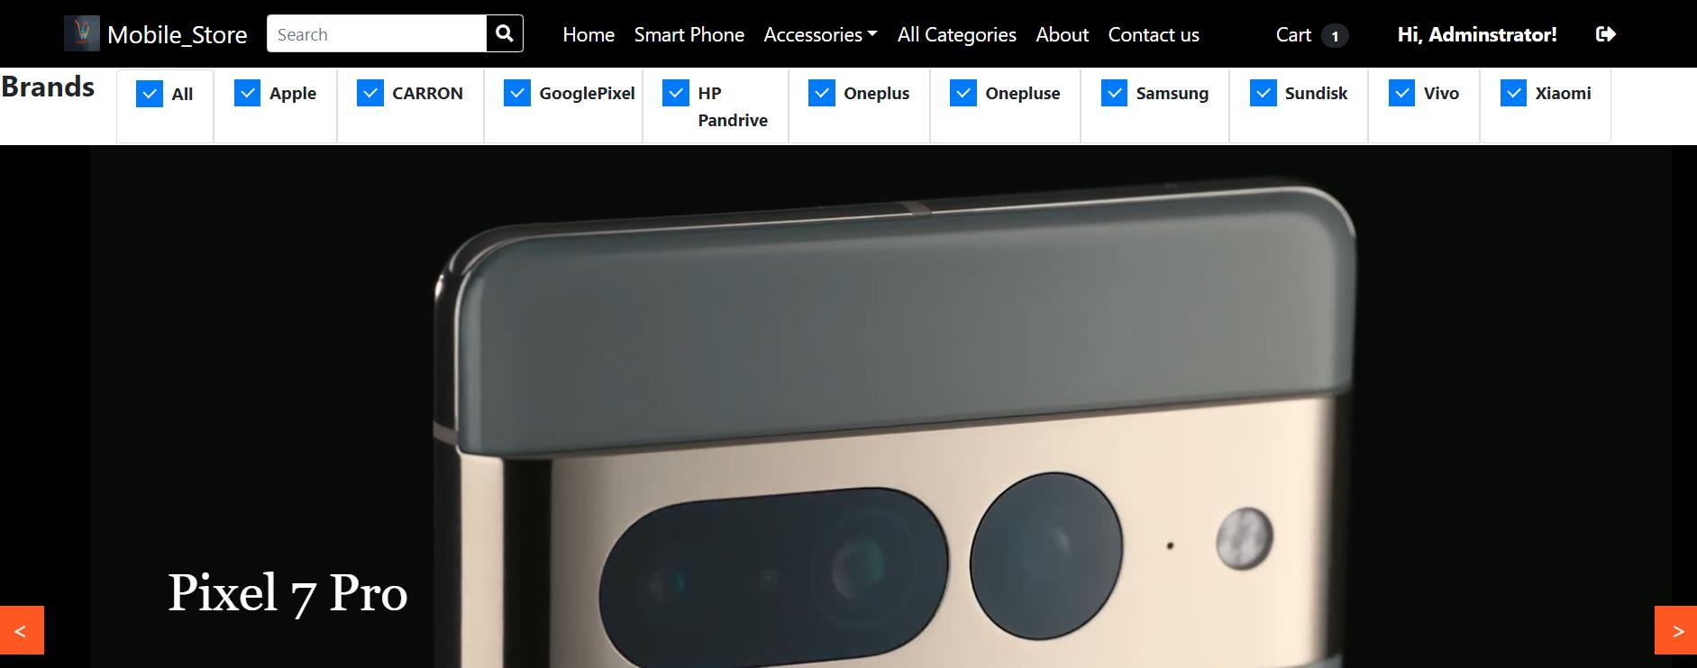
Homepage

Slide 40
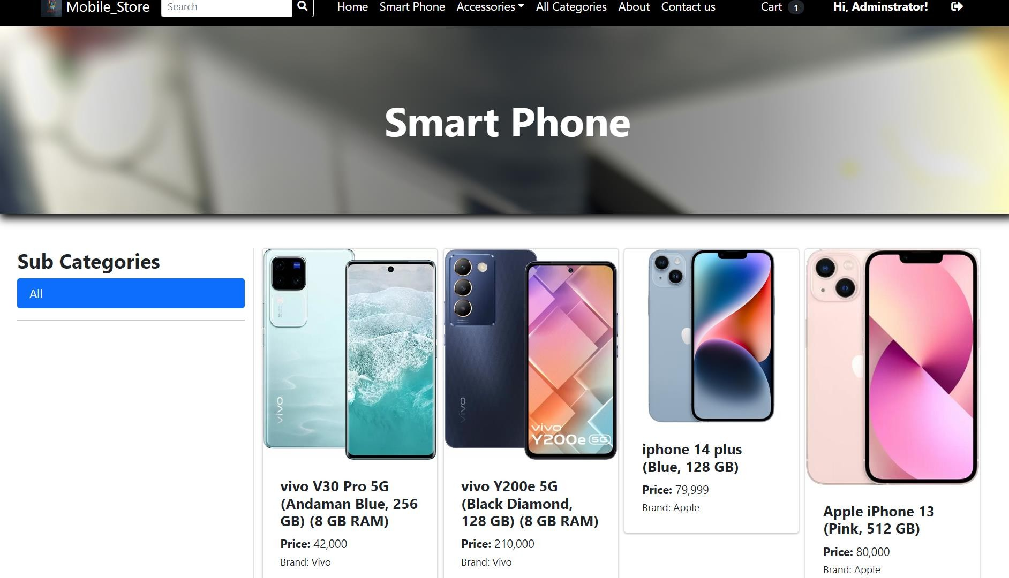
Product

Slide 41
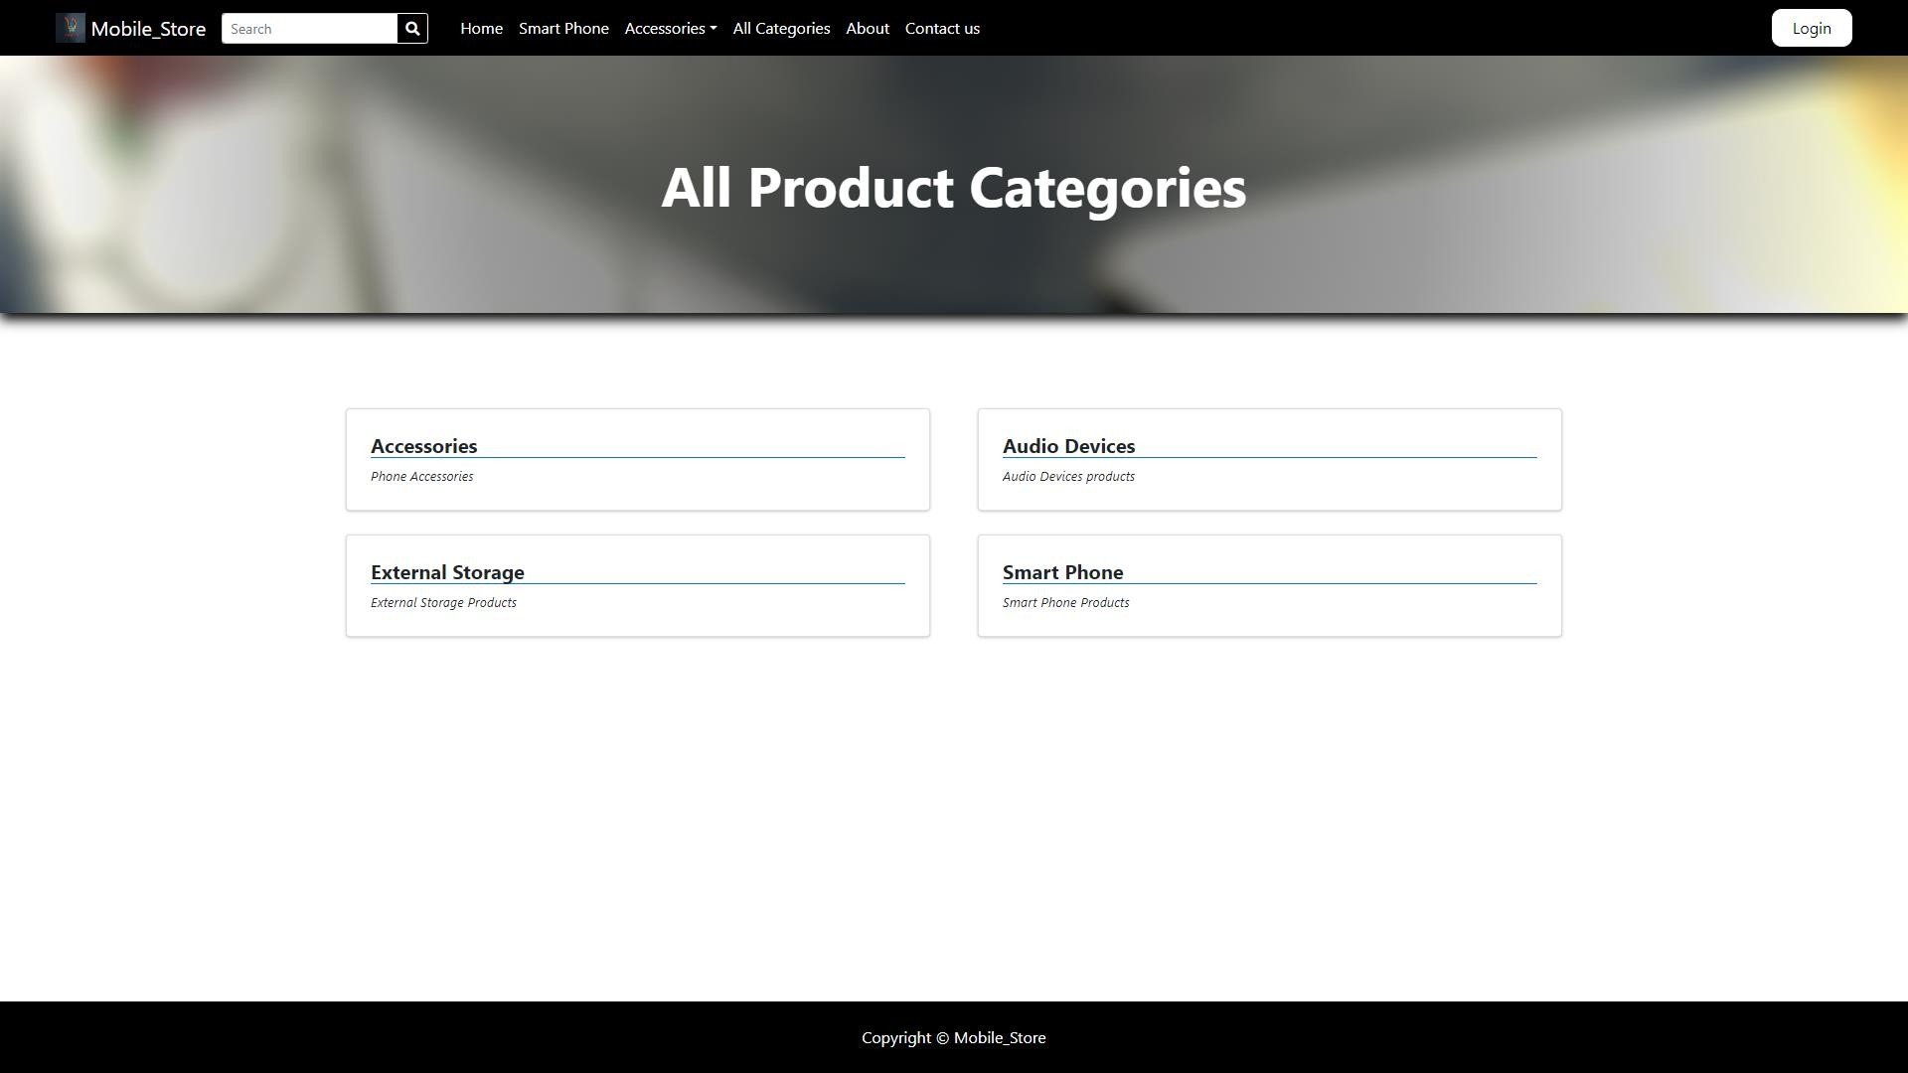
Category

Slide 42
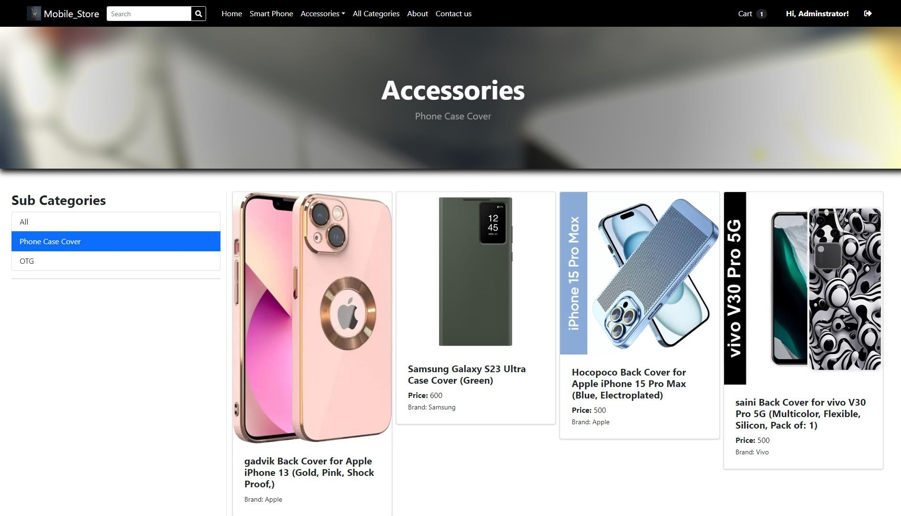
Subcategory : Accessories

Slide 43
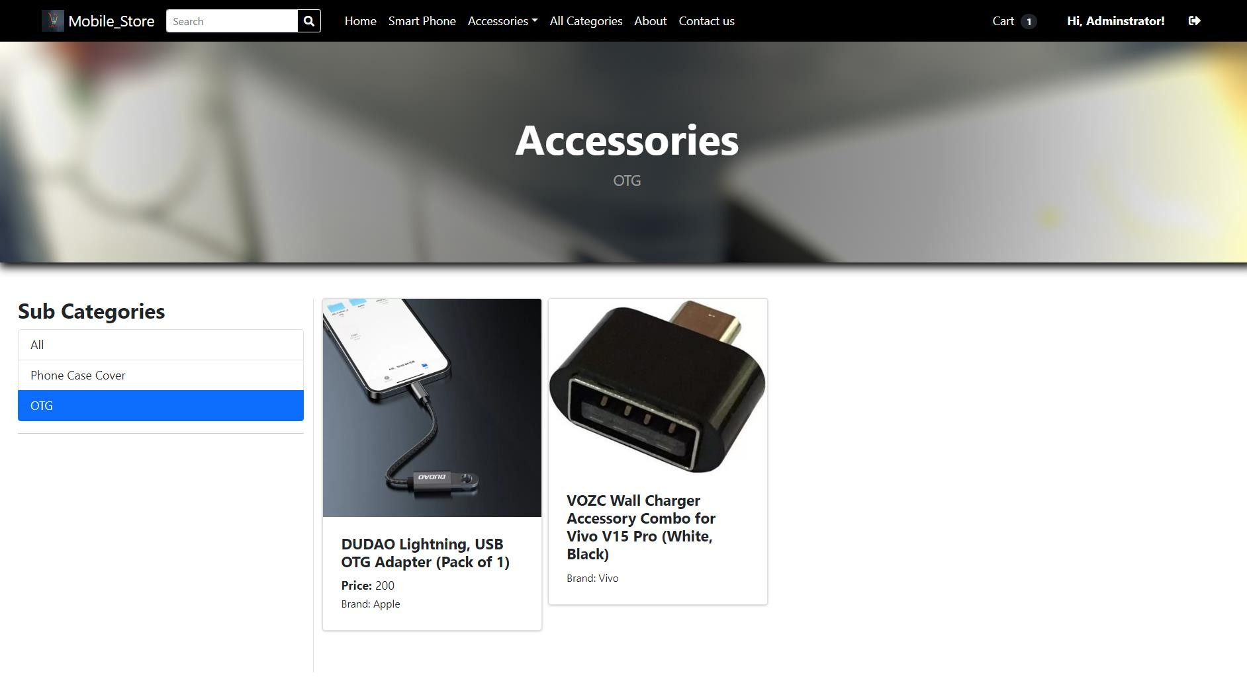
Subcategory : Accessories

Slide 44
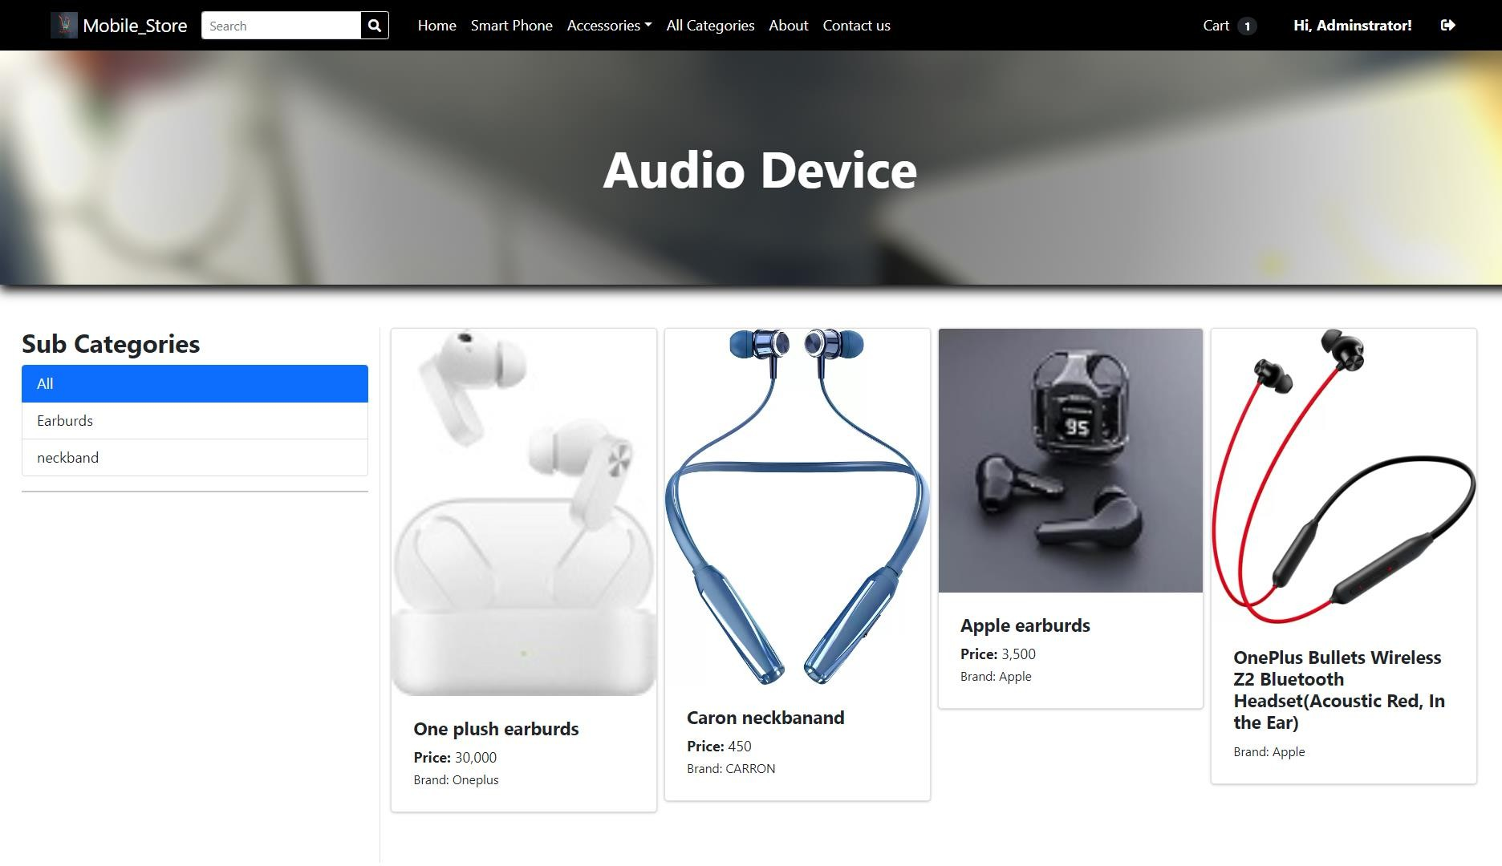
Subcategory : Audio Device

Slide 45
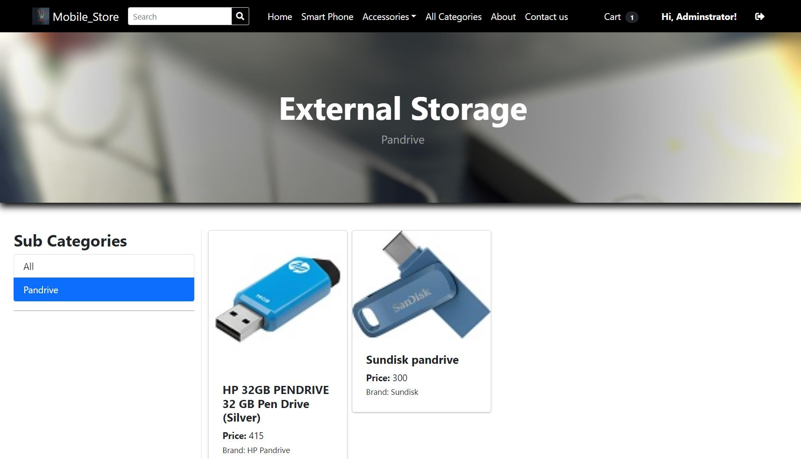
Subcategory : External Storage

Slide 46
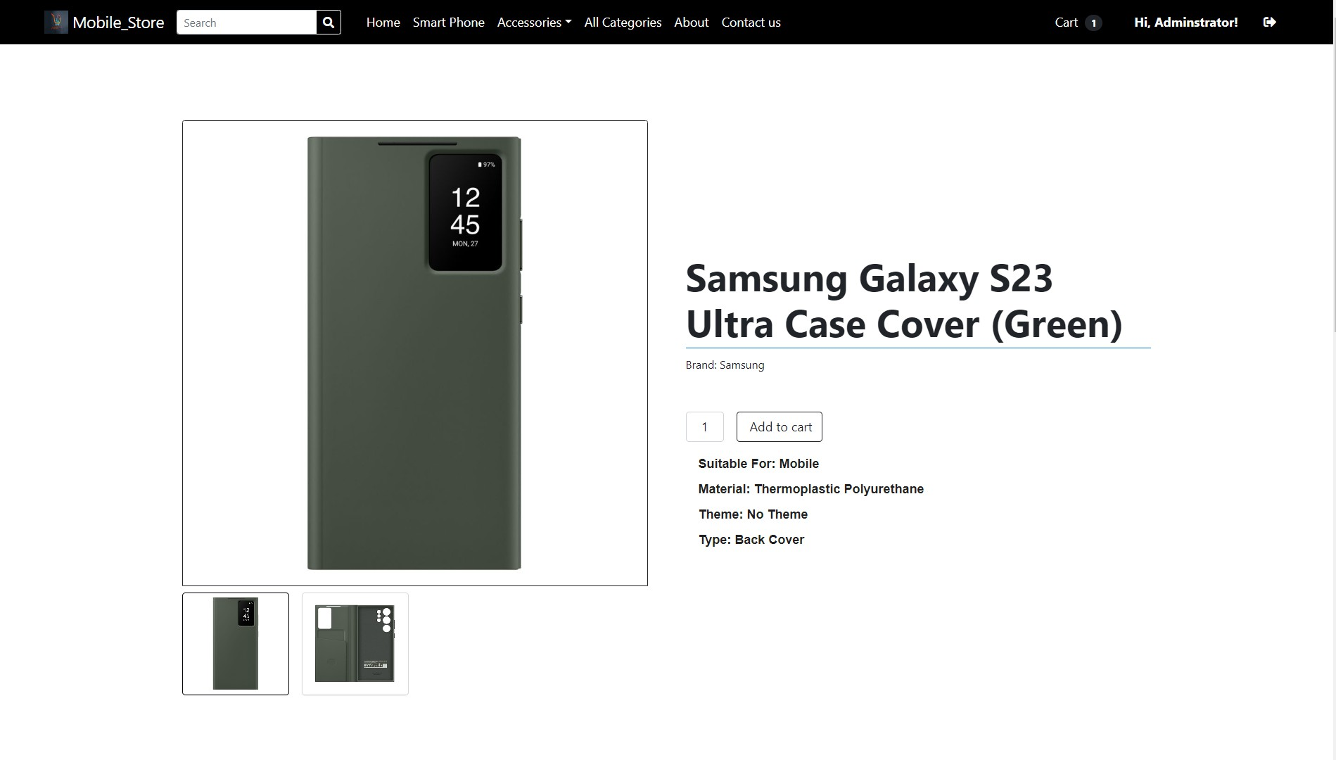
Product Description

Slide 47
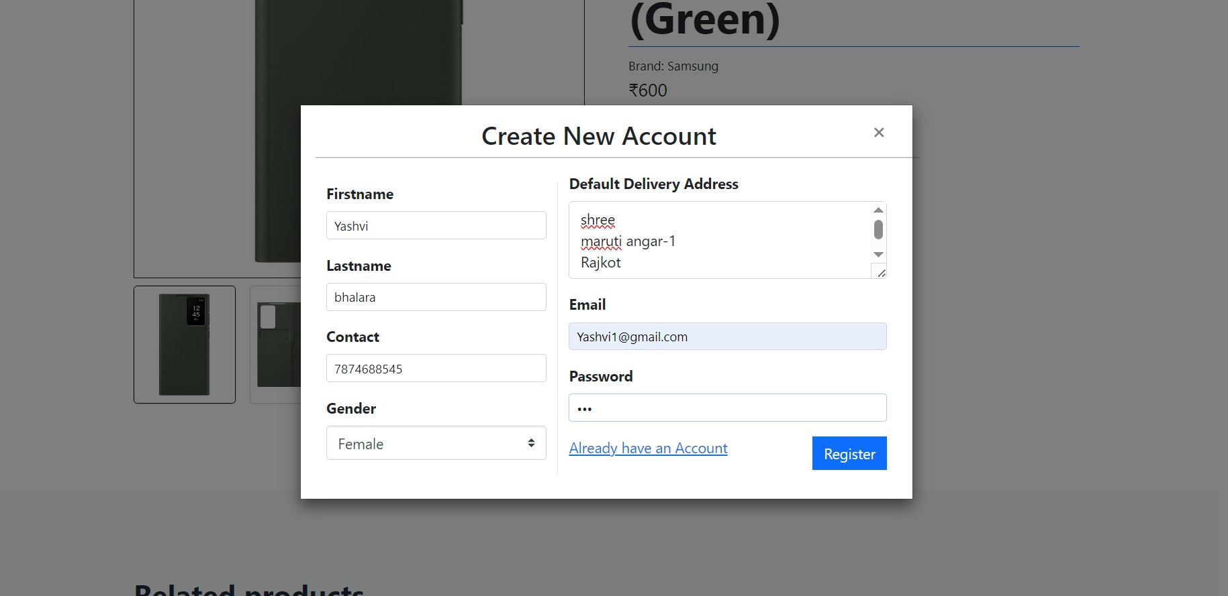
Registration

Slide 48
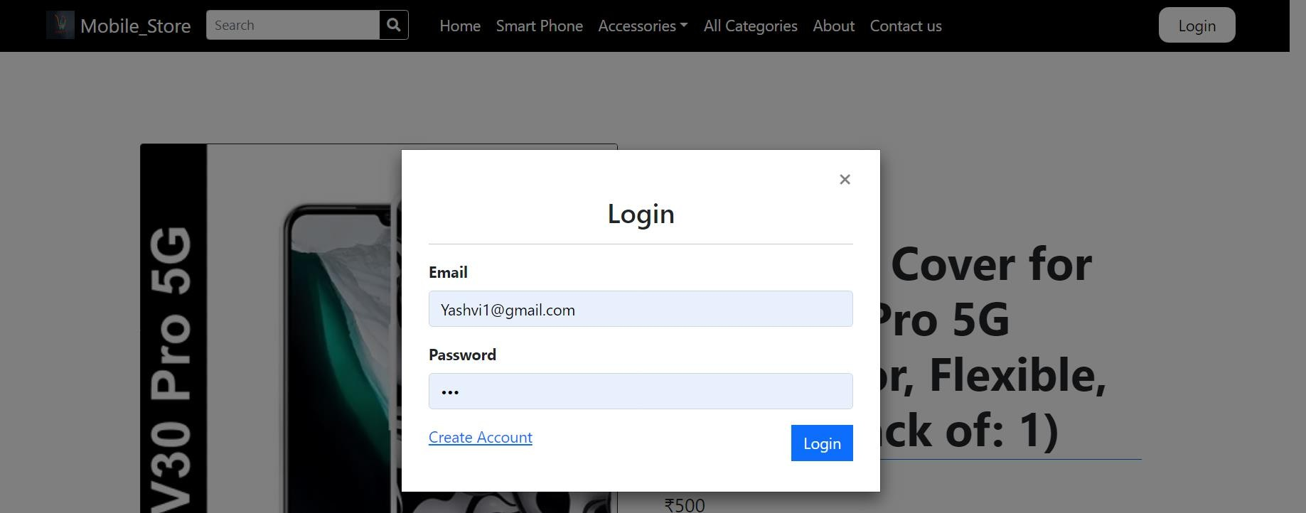
Login

Slide 49
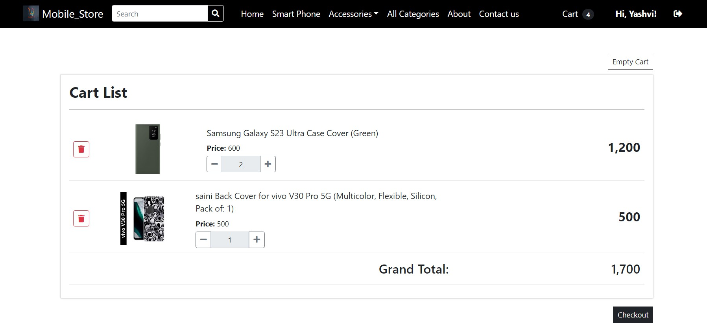
Cart

Slide 50
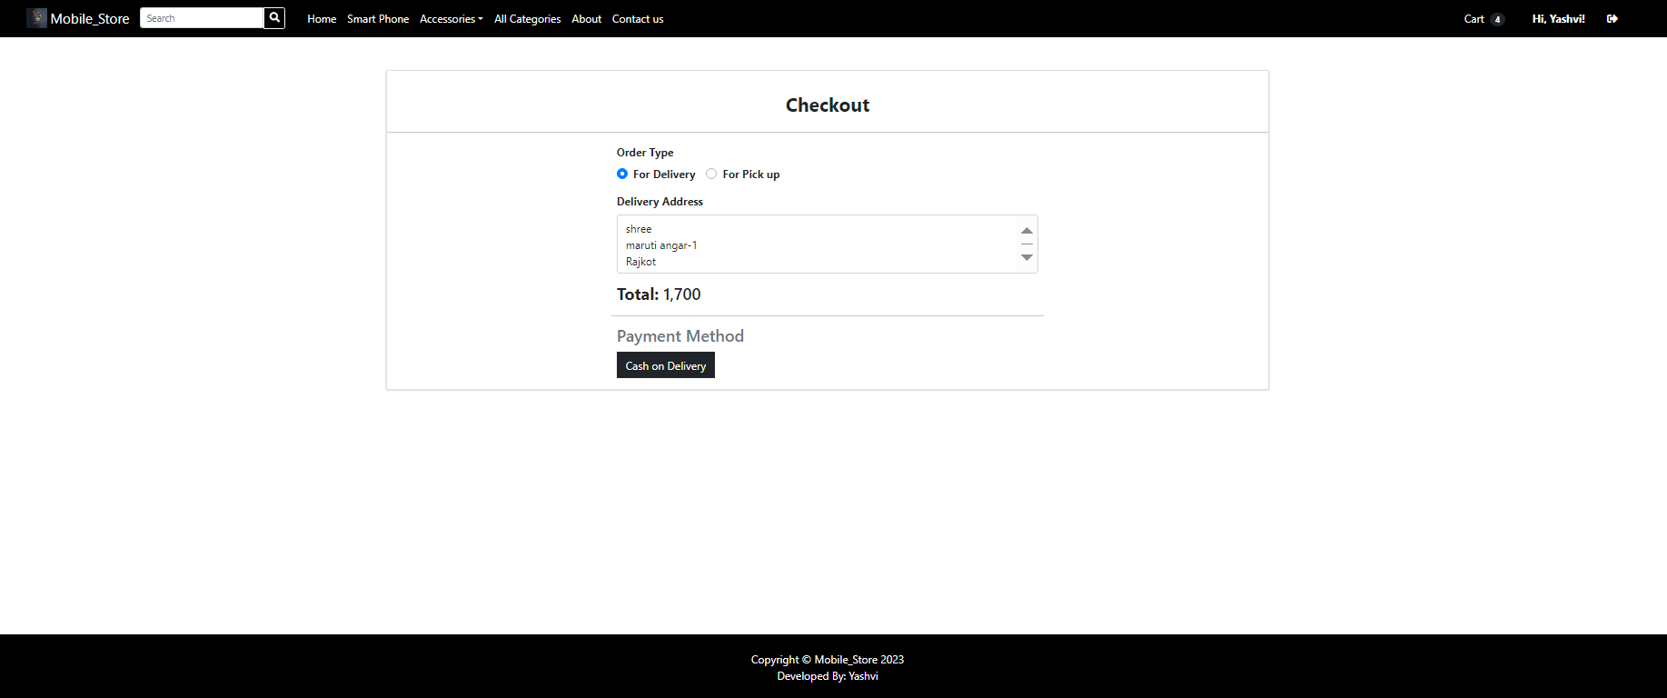
Bill

Slide 51
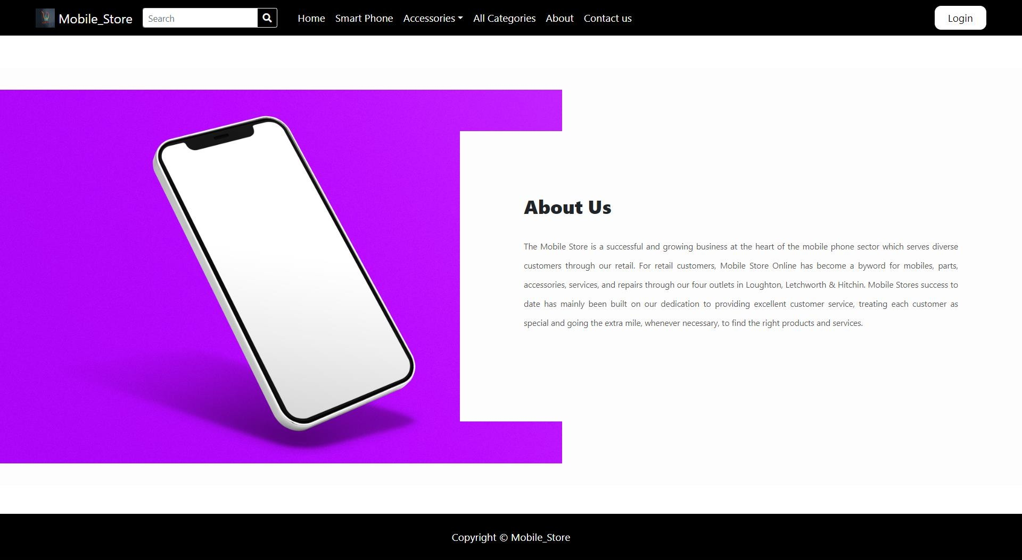
About Us

Slide 52
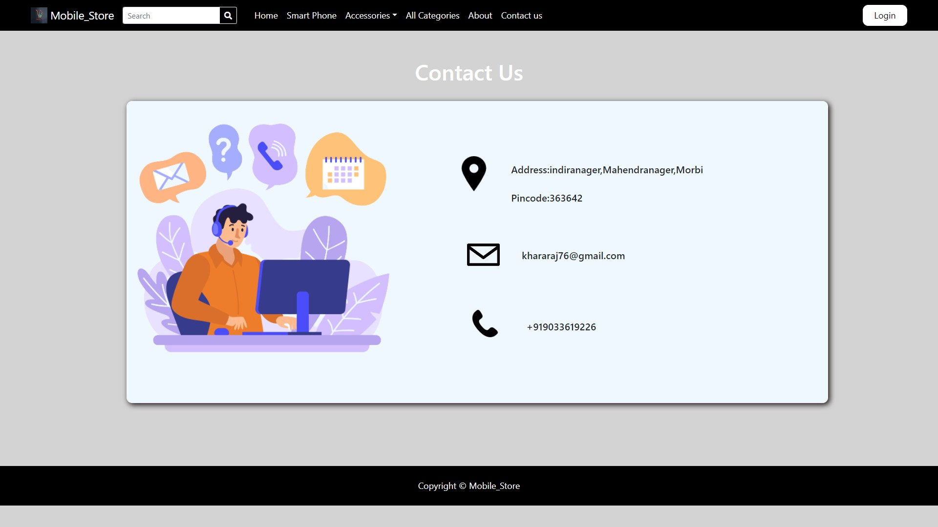
Contact Us

Slide 53
Implementation
Admin Panel :-

Slide 54
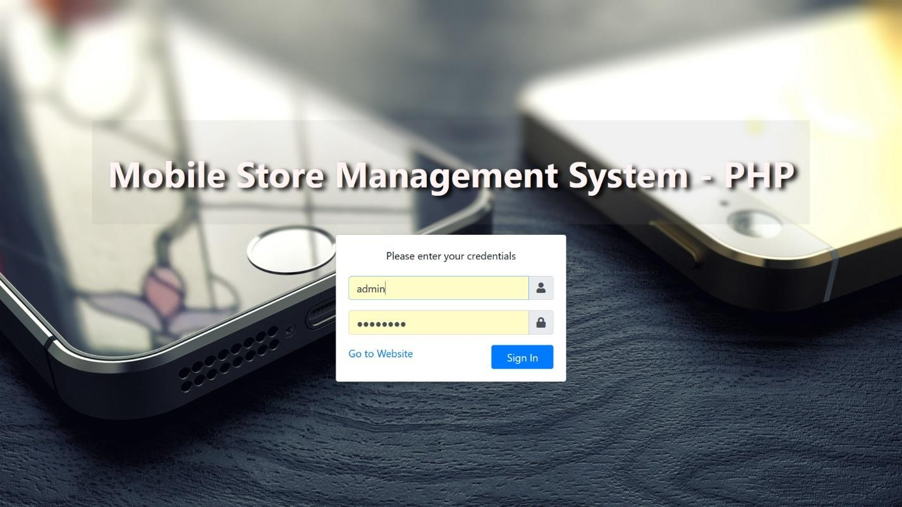
Admin : Login

Slide 55
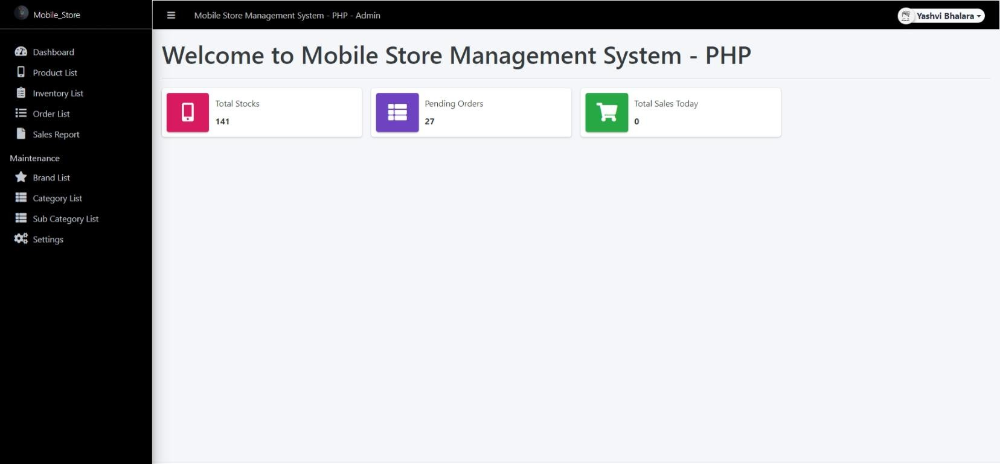
Dashboard

Slide 56
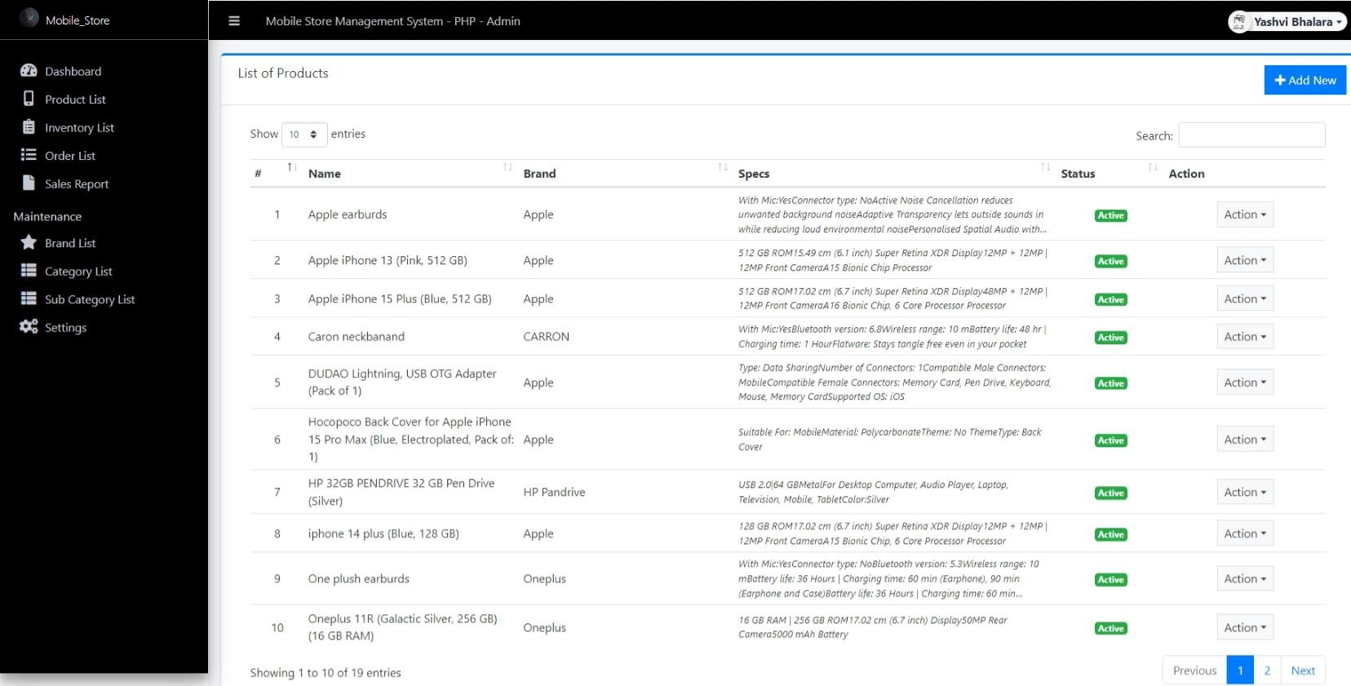
Add Product

Slide 57
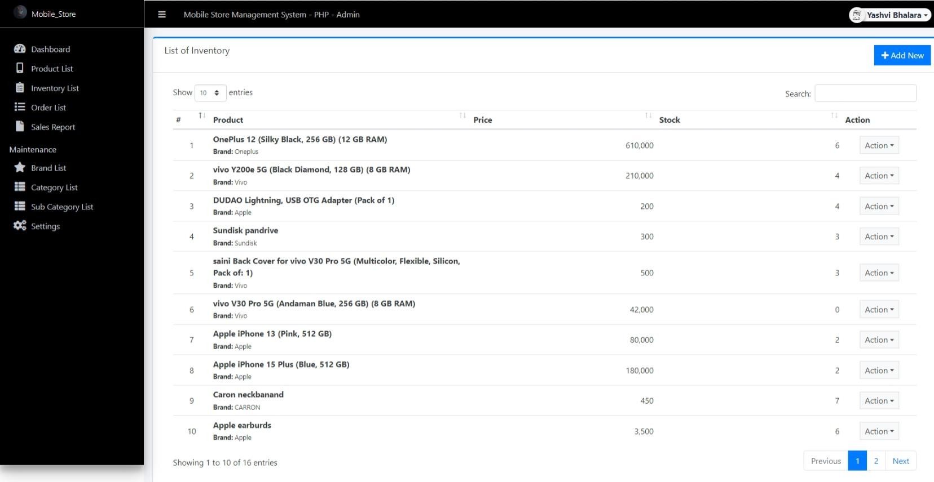
Invetory List

Slide 58
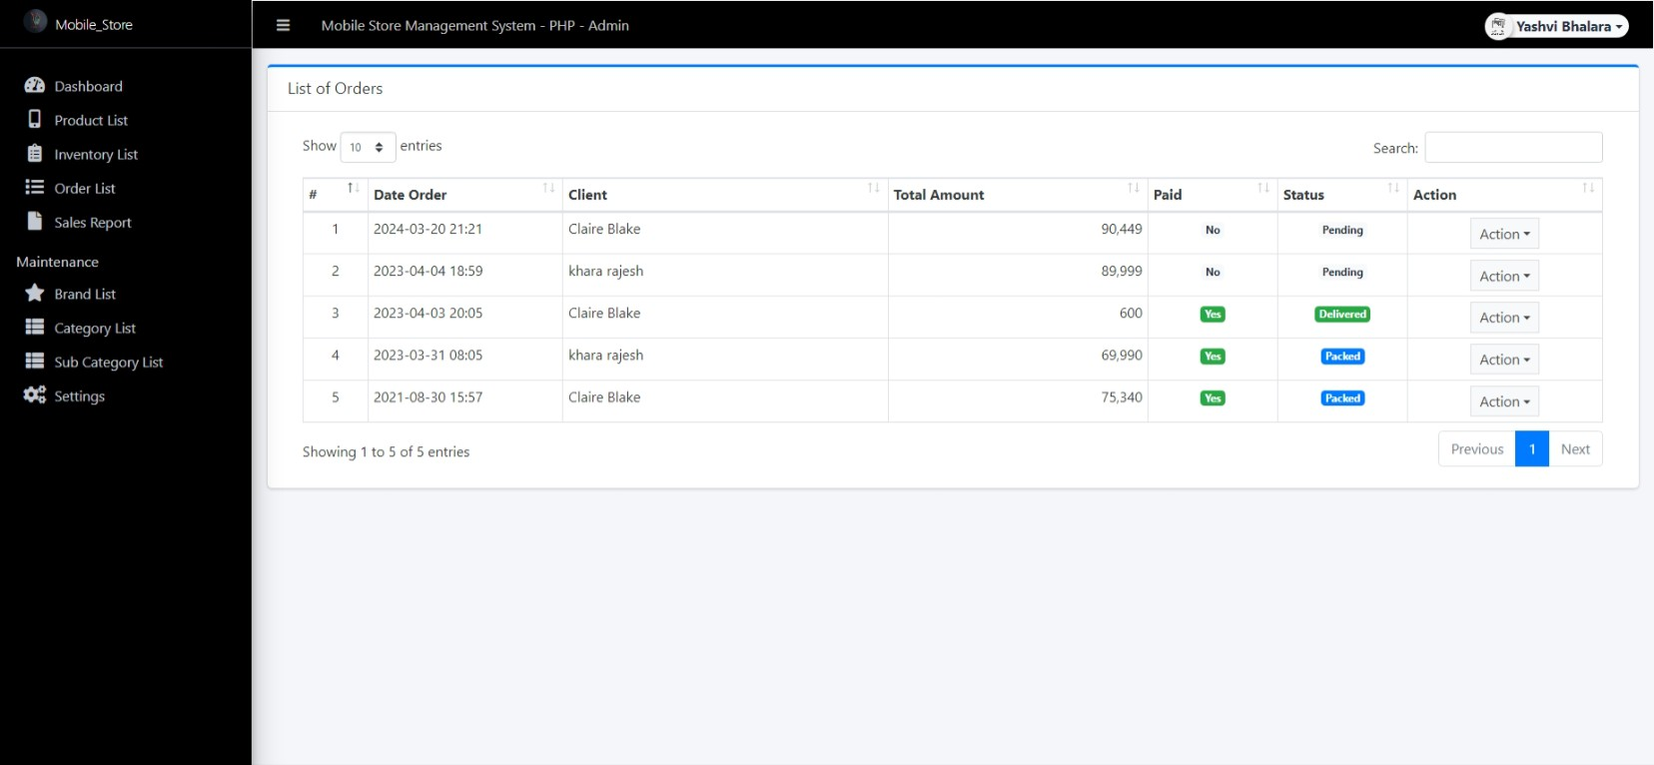
Order List

Slide 59
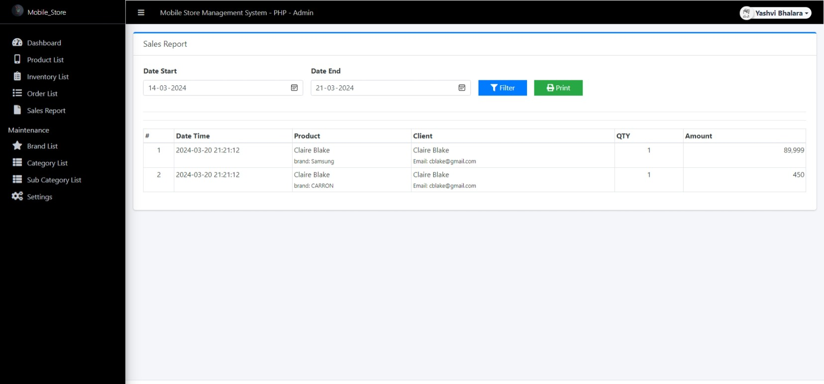
Sales Report

Slide 60
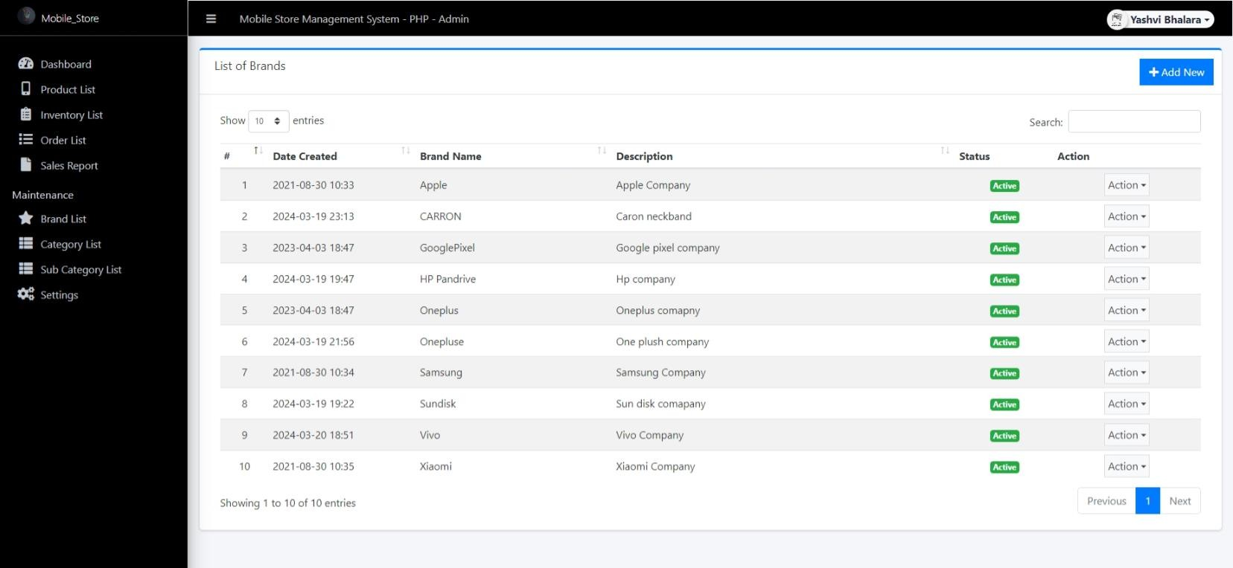
Brand List

Slide 61
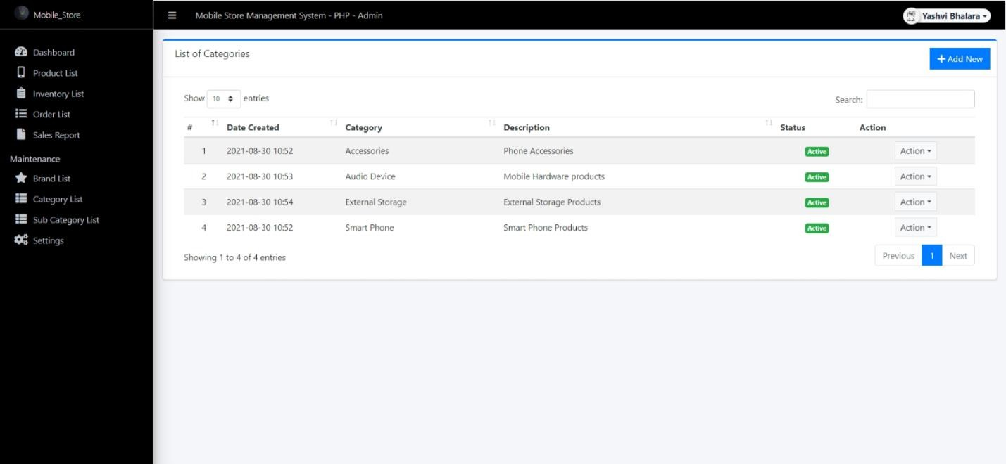
Category List

Slide 62
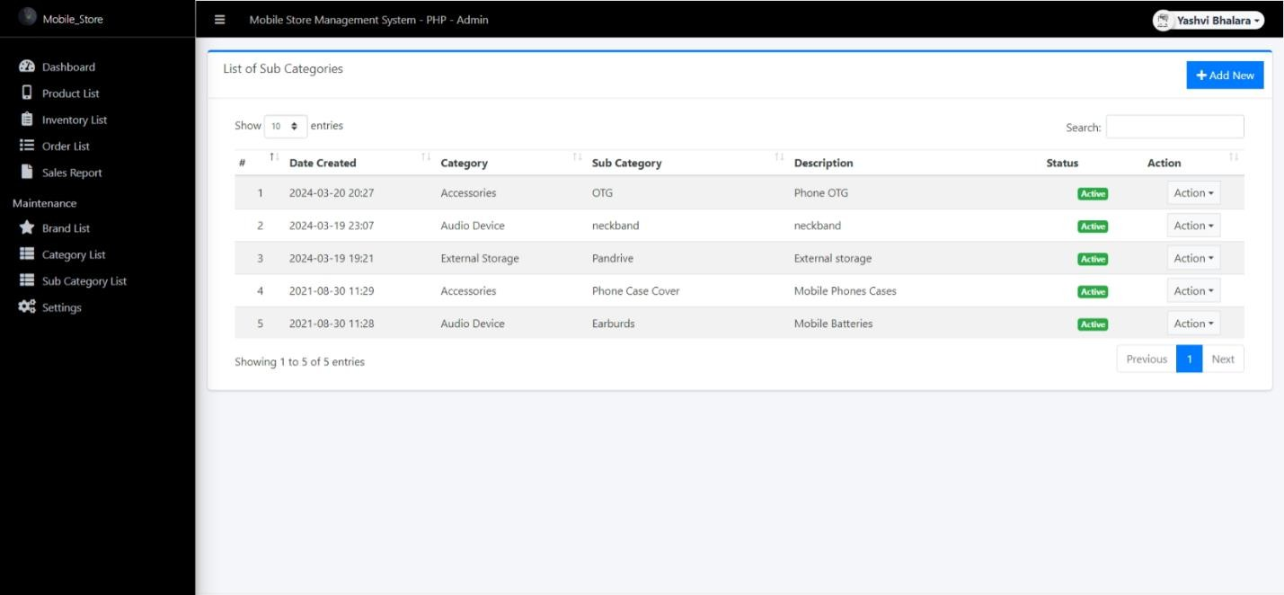
Sub Category

Slide 63
Limitations

Slide 64
Limitations
Competition: There are many other LMS platforms available, making it challenging to stand out and attract users.
Technical Issues: The platform may experience slow loading times, crashes, or bugs that disrupt the learning experience.
Content Limitations: Some LMS platforms may have a limited selection of courses, restricting learners’ choices compared to larger platforms.
Accessibility Challenges: Users may face issues accessing the platform on certain devices or in areas with poor internet connectivity.
User Engagement: Keeping learners motivated and engaged can be difficult, especially in self-paced courses without interactive elements.
71

Slide 65
Future Scope

Slide 66
Future Scope
Real-Time Progress Tracking: Implementing features that allow learners and instructors to track progress in real-time, providing insights into completed modules, quiz scores, and overall performance.
Interactive Learning Tools: Introducing AI chatbots, virtual tutors, and discussion forums to improve learner engagement and provide instant support.
Gamification & Certifications: Adding gamification elements like leaderboards, badges, and completion certificates to boost motivation and encourage learning.
Live Classes & Webinars: Enabling live video sessions, webinars, and virtual classrooms for a more interactive and engaging learning environment.
73

Slide 67
Conclusion

Slide 68
Conclusion
An online Learning Management System (LMS) helps make learning easier and more accessible for people everywhere. It provides a structured way to take courses, track progress, and improve skills.
I have created an LMS that offers useful features to support both learners and teachers. With future updates and new technologies.
75

Slide 69
Reference

Slide 70
Reference
www.w3schools.com
www.javatpoint.com
www.stackflow.com
www.tutorialpoint.com
77

Slide 71



Thank You

